Slide 1
Text in Databases Charles Severance www.pg4e.com/lectures/04-Text.sql

Slide 2
Generating Test Data

Slide 3
Exploring performance
We can't really explore performance if we only have 5 records
So before we play a bit with performance, we need to make up some data

Slide 4
Generating lots of Random Data
We use repeat() to generate long strings (horizontal)
We use generate_series() to generate lots of rows (vertical)
Like Python's range
We use random() to make rows unique
Floating point 0 <= random() <= 1.0

Slide 5
discuss=> select random(), random(), trunc(random()*100);
random | random | trunc
-------------------+-------------------+-------
0.192553216125816 | 0.751528221182525 | 91
discuss=> select repeat('Neon ', 5);
repeat
---------------------------
Neon Neon Neon Neon Neon
discuss=> select generate_series(1,5);
generate_series
-----------------
1
2
3
4
5

Slide 6
discuss=> select 'https://sql4e.com/neon/' ||
discuss-> trunc(random()*1000000) || repeat('Lemon', 5) ||
discuss-> generate_series(1,5);
?column?
---------------------------------------------------------
https://sql4e.com/neon/225845LemonLemonLemonLemonLemon1
https://sql4e.com/neon/679405LemonLemonLemonLemonLemon2
https://sql4e.com/neon/603925LemonLemonLemonLemonLemon3
https://sql4e.com/neon/917014LemonLemonLemonLemonLemon4
https://sql4e.com/neon/428156LemonLemonLemonLemonLemon5

Slide 7
Text Functions

Slide 8
Many Text Functions
Where Clause Operators
LIKE / ILIKE / NOT LIKE / NOT ILIKE
SIMILAR TO/ NOT SIMILAR TO (cover later as regular expressions)
= > < >= <= BETWEEN IN
Manipulate SELECT Results / WHERE clause
lower(), upper()

Slide 9
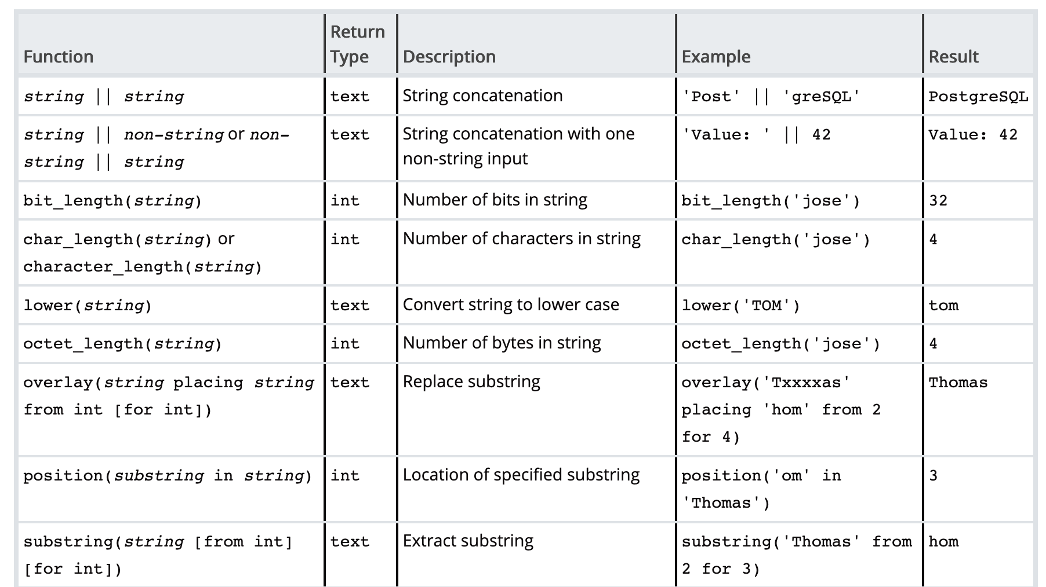
https://www.postgresql.org/docs/11/functions-string.html

Slide 10
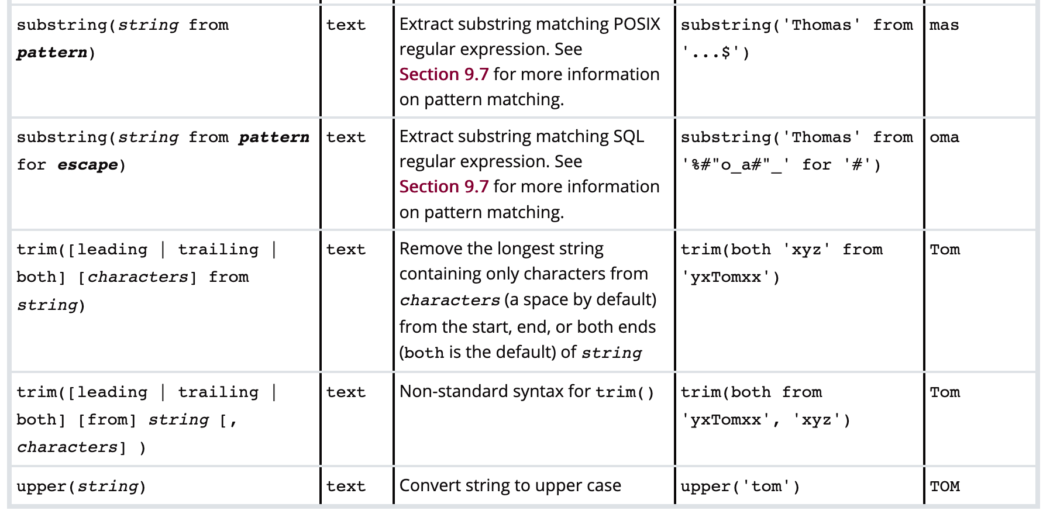
https://www.postgresql.org/docs/11/functions-string.html

Slide 11
CREATE TABLE textfun (
content TEXT
);
CREATE INDEX textfun_b ON textfun (content);
discuss=> SELECT pg_relation_size('textfun'), pg_indexes_size('textfun');
pg_relation_size | pg_indexes_size
------------------+-----------------
0 | 8192

Slide 12
discuss=> SELECT pg_relation_size('textfun'), pg_indexes_size('textfun');
pg_relation_size | pg_indexes_size
------------------+-----------------
0 | 8192
INSERT INTO textfun (content)
SELECT (CASE WHEN (random() < 0.5)
THEN 'https://www.pg4e.com/neon/'
ELSE 'http://www.pg4e.com/LEMONS/'
END) || generate_series(100000,200000);
discuss=> SELECT pg_relation_size('textfun'), pg_indexes_size('textfun');
pg_relation_size | pg_indexes_size
------------------+-----------------
6832128| 8585216

Slide 13
discuss=> SELECT content FROM textfun LIMIT 5;
content
---------------------------------
http://www.pg4e.com/LEMONS/100000
http://www.pg4e.com/LEMONS/100001
https://www.pg4e.com/neon/100002
http://www.pg4e.com/LEMONS/100003
http://www.pg4e.com/LEMONS/100004
discuss=> SELECT pg_relation_size('textfun'), pg_indexes_size('textfun');
pg_relation_size | pg_indexes_size
------------------+-----------------
6832128 | 5931008
INSERT INTO textfun (content)
SELECT (CASE WHEN (random() < 0.5)
THEN 'https://www.pg4e.com/neon/'
ELSE 'http://www.pg4e.com/LEMONS/'
END) || generate_series(100000,200000);

Slide 14
Text Functions
SELECT content FROM textfun WHERE content LIKE '%150000%';
-- https://www.pg4e.com/neon/150000
SELECT upper(content) FROM textfun WHERE content LIKE '%150000%';
-- HTTPS://WWW.PG4E.COM/NEON/150000
SELECT lower(content) FROM textfun WHERE content LIKE '%150000%';
-- https://www.pg4e.com/neon/150000
SELECT right(content, 4) FROM textfun WHERE content LIKE '%150000%';
-- 0000
SELECT left(content, 4) FROM textfun WHERE content LIKE '%150000%';
-- http

Slide 15
Moar Text Functions
SELECT content FROM textfun WHERE content LIKE '%150000%';
-- https://www.pg4e.com/neon/150000
SELECT strpos(content, 'ttps://') FROM textfun WHERE …
-- 2
SELECT substr(content, 2, 4) FROM textfun WHERE …
-- ttps
SELECT split_part(content, '/', 4) FROM textfun WHERE …
-- neon
SELECT translate(content, 'th.p/', 'TH!P_') FROM textfun …
-- HTTPs:__www!Pg4e!com_neon_150000

Slide 16
B-Tree Index performance
discuss=> explain analyze SELECT content FROM textfun WHERE content LIKE 'racing%';
Index Only Scan using textfun_b on textfun
Index Cond: ((content >= 'racing'::text) AND (content < 'racinh'::text))
Filter: (content ~~ 'racing%'::text)
Heap Fetches: 0
Execution Time: 0.011 ms
discuss=> explain analyze SELECT content FROM textfun WHERE content LIKE '%racing%';
Seq Scan on textfun
Filter: (content ~~ '%racing%'::text)
Rows Removed by Filter: 100001
Execution Time: 10.271 ms
discuss=> explain analyze SELECT content FROM textfun WHERE content ILIKE 'racing%';
Seq Scan on textfun
Filter: (content ~~* 'racing%'::text)
Rows Removed by Filter: 100001
Execution Time: 29.958 ms
CREATE INDEX textfun_b ON textfun (content);

Slide 17
discuss=> explain analyze SELECT content FROM textfun WHERE content
discuss-> LIKE '%150000%';
Seq Scan on textfun
Filter: (content ~~ '%150000%'::text)
Rows Removed by Filter: 100000
Execution Time: 14.923 ms
discuss=> explain analyze SELECT content FROM textfun WHERE content
discuss-> LIKE '%150000%' LIMIT 1;
Limit (cost=0.00..208.40 rows=1 width=33)
-> Seq Scan on textfun
Filter: (content ~~ '%150000%'::text)
Rows Removed by Filter: 50000
Planning Time: 0.116 ms
Execution Time: 8.732 ms

Slide 18
discuss=> explain analyze SELECT content FROM textfun
discuss-> WHERE content IN ('http://www.pg4e.com/neon/150000',
diacuss-> 'https://www.pg4e.com/neon/150000');
Index Only Scan using textfun_b on textfun
Index Cond: (content = ANY ('{http://www.pg4e.com/neon/150000,
https://www.pg4e.com/neon/150000}'::text[]))
Execution Time: 0.036 ms
discuss=> explain analyze SELECT content FROM textfun
discuss-> WHERE content
discuss-> IN (SELECT content FROM textfun WHERE content LIKE '%150000%');
Nested Loop
-> HashAggregate
Group Key: textfun_1.content
-> Seq Scan on textfun textfun_1
Filter: (content ~~ '%150000%'::text)
Rows Removed by Filter: 100000
-> Index Only Scan using textfun_b on textfun
Index Cond: (content = textfun_1.content)
Execution Time: 14.302 ms

Slide 19
Character Sets https://www.py4e.com/lessons/network

Slide 20
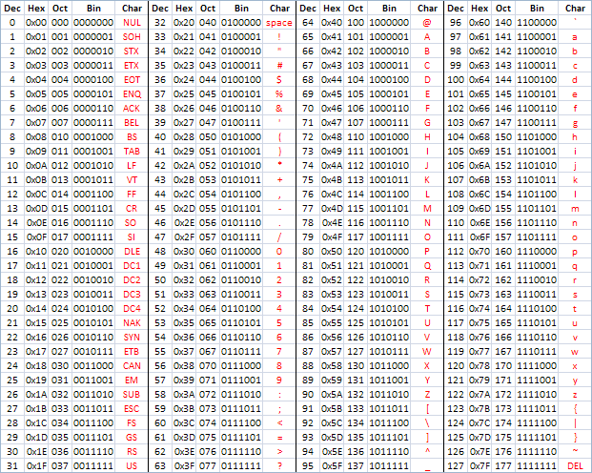
ASCII
American Standard Code for Information Interchange
https://en.wikipedia.org/wiki/ASCII
http://www.catonmat.net/download/ascii-cheat-sheet.png

Slide 21
Representing Simple Strings
"In the old days" - each character is represented by a number between 0 and 127 stored in 8 bits of memory
We refer to "8 bits of memory as a "byte" of memory
The ascii() function tells us the numeric value of a single ASCII character
The chr() function maps from an integer to a character
discuss=> select ascii('H'), ascii('e'), ascii('l'), chr(72), chr(42);
ascii | ascii | ascii | chr | chr
-------+-------+-------+-----+-----
72 | 101 | 108 | H | *

Slide 22
discuss=> select ascii('H'), ascii('e'), ascii('l'), chr(72), chr(42);
ascii | ascii | ascii | chr | chr
-------+-------+-------+-----+-----
72 | 101 | 108 | H | *
In the 1960s and 1970s, we just assumed that one byte was one character

Slide 23
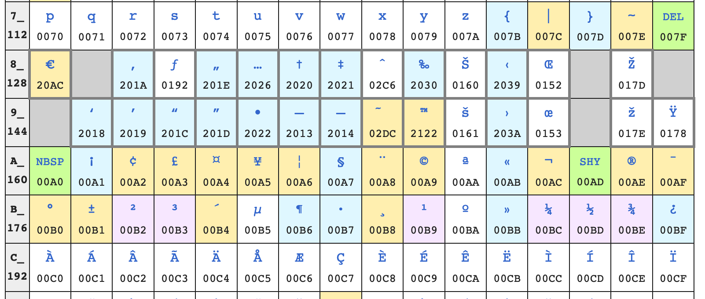
Beyond 127…
To be "more international" they defined characters 128-255 but inconsistently
https://en.wikipedia.org/wiki/ISO/IEC_8859-1 (latin1)
https://en.m.wikipedia.org/wiki/Windows-1252
Don't cut and paste code or text from PDFs ☹

Slide 24
Overlapping character sets
We needed more than 128 new characters globally so 128-255 could mean different things based on context
ISO 8859-2 for Eastern European languages
ISO 8859-3 for Turkish, Maltese and Esperanto
ISO 8859-5 for Cyrillic
But these were not self-documenting you needed to know the character set outside the data of the file ---- Confusion

Slide 25
Unicode – All Characters in One Set
Unicode is 32 / 21 bits (long story)
Unicode 12.1
137,000 characters
150 character sets
discuss=> select chr(72), chr(231), chr(20013);
chr | chr | chr
-----+-----+-----
H | ç | 中
https://en.wikipedia.org/wiki/List_of_Unicode_characters

Slide 26
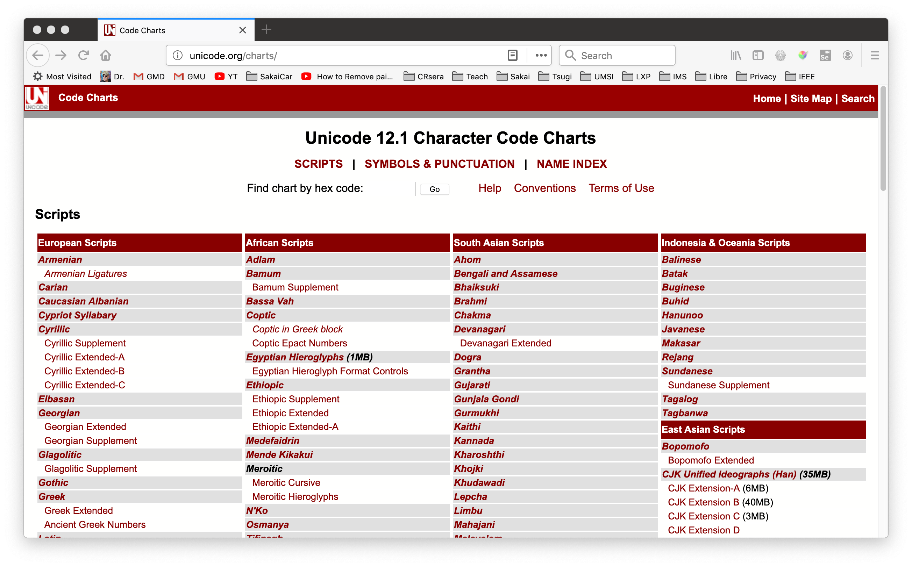
http://unicode.org/charts/

Slide 27
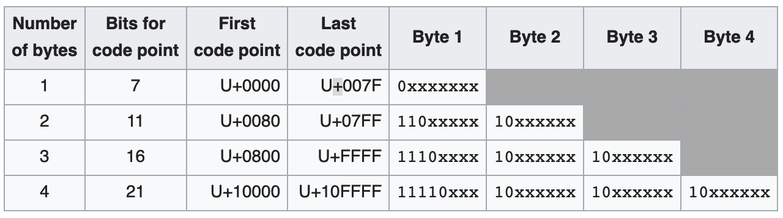
We can't afford 32 bit characters
UTF-8 is a compression scheme for Unicode
Represents 21 bits in 8-32 bits
0-128 are ASCII
128-255 are signals
https://en.wikipedia.org/wiki/UTF-8

Slide 28
Space – the final frontier…
discuss=> SELECT char_length('学习管理'), octet_length('学习管理'),
discuss-> bit_length('学习管理'), ascii('学');
char_length | octet_length | bit_length | ascii
-------------+--------------+------------+-------
4 | 12 | 96 | 23398
… for Unicode

Slide 29
UTF-8 Designed for Transition
Pure ASCII is UTF-8 / no conversion
Partial auto detect/convert of
Latin-1 variants
1252 variants

Slide 30
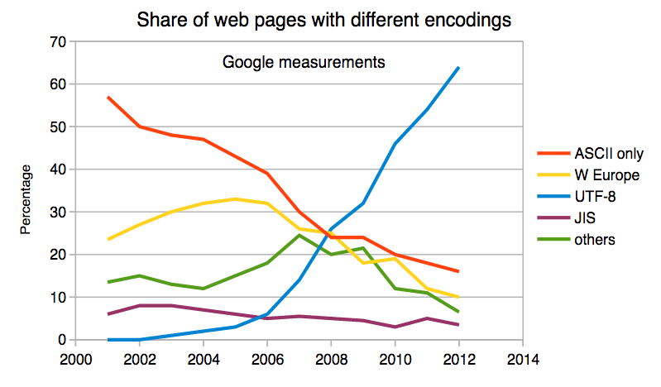
UTF-8 Is Dominant
Rapid uptake after 2004
UTF-8 is 94% of all web pages in 2019
https://w3techs.com/technologies/details/en-utf8/all/all

Slide 31
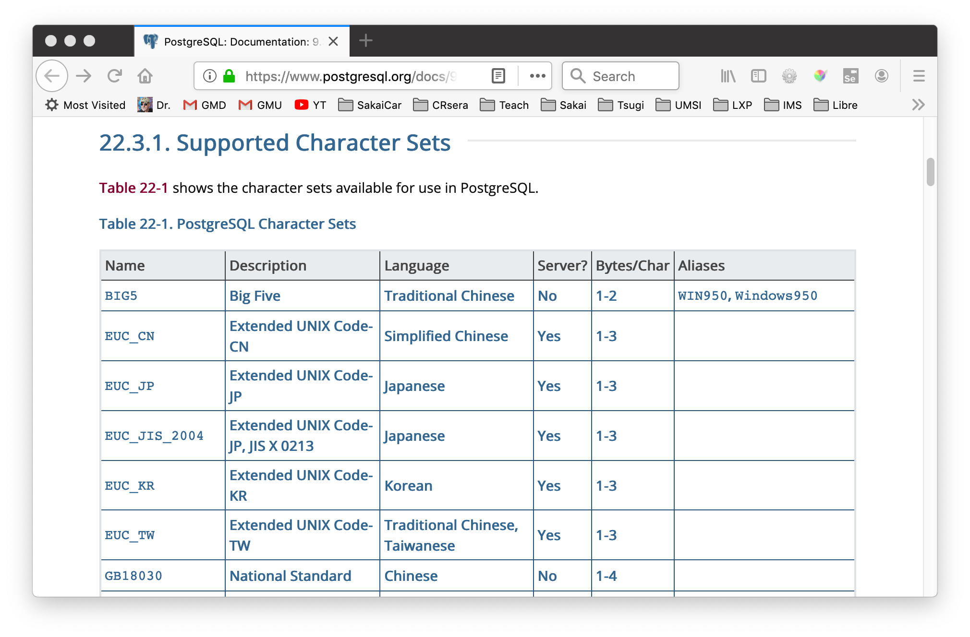

Slide 32
discuss=> SHOW SERVER_ENCODING;
server_encoding
-----------------
UTF8
(1 row)

Slide 33
Character Sets In Python https://www.py4e.com/lessons/network

Slide 34
Python 3 and Unicode
Strings in memory are Unicode
The "bytes" type is for 8-bit characters
Strings "at rest" are generally stored UTF-8 for space and interoperability
Files
Network resources
Database tables
>>> x = b'abc'
>>> type(x)
<class 'bytes'>
>>> x = '이광춘'
>>> type(x)
<class 'str'>
>>> x = u'이광춘'
>>> type(x)
<class 'str'>

Slide 35
PYTHON
STRINGS
UNICODE
UTF-8 NETWORK
DATA
DECODE
UTF-8 FILE
DATA
DECODE
ENCODE
ENCODE
UTF-8
DATABASE
DATA
DECODE
ENCODE

Slide 36
Opening a File
open(file, mode='r', buffering=-1,
encoding=None, errors=None, newline=None,
closefd=True, opener=None)
encoding is the name of the encoding used to decode or encode the file. This should only be used in text mode. The default encoding is platform dependent (whatever locale.getpreferredencoding() returns), but any text encoding supported by Python can be used. See the codecs module for the list of supported encodings.
https://docs.python.org/3/library/functions.html#open

Slide 37
Reading Network Data
When we read data from an network resource, we must decode it based on the character set so it is properly represented in Python 3 as a UNICODE string
while True:
data = mysock.recv(512)
if ( len(data) < 1 ) :
break
mystring = data.decode()
print(mystring)

Slide 38
Database Data
When you interact with a database from Python all conversion between Unicode and UTF-8 is done implicitly
The Python database connector (i.e. psycopg2) knows the internal storage format of the database and automatically handles all conversion

Slide 39
Inside Hashes

Slide 40
A hash function is any function that can be used to map data of arbitrary size onto data of a fixed size.
https://en.wikipedia.org/wiki/Hash_function

Slide 41
Uses of Hashes
Checksum – see if a message was altered in transit
Cryptography / Signature – See if a message came from a trusted source
Good functions enable fast lookup of data
Python dictionaries
Database tables

Slide 42
Good Hash Functions
Deterministic – There can be no randomness – must get the same output for the same input
Uniform Distribution – Should have an equal chance of generating any value with the range of its outputs – values don't cluster or collide
Sensitive – Any change in input should provide a change in output
One-way – You should not be able to derive the input from the output (cannot reverse)

Slide 43
Special Math for Hash Computation
Bitwise operators
<< left shift
^ Exclusive or
& And
https://www.pg4e.com/code/hashmath.py
x = 15
y = ord('H')
print('x', x, format(x, '08b'))
print('y', y, format(y, '08b'))
print('x^y ', format(x^y, '08b'));
print('x&y ', format(x&y, '08b'));
print('x<<1', format(x<<1, '08b'));
$ python3 hashmath.py
x 15 00001111
y 72 01001000
x^y 01000111
x&y 00001000
x<<1 00011110

Slide 44
$ python3 simplehash.py
Enter a string: Hello
H 01001000 1001000 072 72
e 01100101 11110101 101 245
l 01101100 110000110 108 390
l 01101100 1101100000 108 864
o 01101111 11010101111 111 1711
000006af 1711
Enter a string: hello
h 01101000 1101000 104 104
e 01100101 10110101 101 181
l 01101100 100000110 108 262
l 01101100 1001100000 108 608
o 01101111 10010101111 111 1199
000004af 1199
Enter a string: ehllo
e 01100101 1100101 101 101
h 01101000 10100010 104 162
l 01101100 100101000 108 296
l 01101100 1000111100 108 572
o 01101111 10000010111 111 1047
00000417 1047
while True:
txt = input("Enter a string: ")
if len(txt) < 1: break
hv = 0;
for let in txt:
hv = ((hv << 1) ^ ord(let)) & 0xffffff;
if ( hv < 2000 ) :
print(let,
format(ord(let), '08b'),
format(hv,'16b'),
format(ord(let), '03d'), hv)
print(format(hv, '08x'), hv)
https://www.pg4e.com/code/simplehash.py

Slide 45
The Science/Math of Hashing
Designing Hash Computations is serious work
National Institute of Standards and Technology (NIST) runs multi-year "competitions" when new hashing algorithms are needed
Sometimes algorithms have flaws that are detected years later and we deprecate them

Slide 46
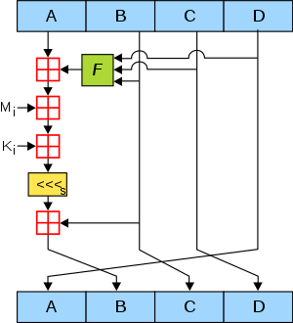
The "Classic" Hash - MD5
128 bit hash
Widely implemented
Broken for cryptography
Can alter data in transit without breaking a signature
Rainbow tables use forward computation and storage to reverse MD5 for short input strings (Password hashing)
https://en.wikipedia.org/wiki/MD5

Slide 47
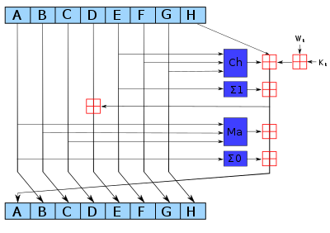
SHA-256 – A Modern Hash
A family of related hashes called "SHA-2"
Created in 2001
discuss=> select md5('hello');
md5
----------------------------------
5d41402abc4b2a76b9719d911017c592
discuss=> select sha256('hello');
sha256
--------------------------------------------------------------------
\x2cf24dba5fb0a30e26e83b2ac5b9e29e1b161e5c1fa7425e73043362938b9824

Slide 48
Indexes and Performance

Slide 49
Lets Build a Web Crawler
Approach
Retrieve a web page from our queue of web pages
Store the web page and look for outgoing links
Add the links we have not already read to a queue
This table will be large and we will look up URLs quite often (100s per retrieved page)

Slide 50
How long is a URL?
CREATE TABLE cr1 (
id SERIAL,
url VARCHAR(128) UNIQUE,
content TEXT
);
discuss=> insert into cr1(url)
discuss-> select repeat('Neon', 1000) || generate_series(1,5000);
ERROR: value too long for type character varying(128)
discuss=>

Slide 51
CREATE TABLE cr2 (
id SERIAL,
url TEXT,
content TEXT
);
discuss=> insert into cr2 (url)
discuss-> select repeat('Neon', 1000) || generate_series(1,5000);
INSERT 0 5000
discuss=> select pg_relation_size('cr2'), pg_indexes_size('cr2');
pg_relation_size | pg_indexes_size
------------------+-----------------
507904 | 0
discuss=> create unique index cr2_unique on cr2 (url);
CREATE INDEX
discuss=> select pg_relation_size('cr2'), pg_indexes_size('cr2');
pg_relation_size | pg_indexes_size
------------------+-----------------
507904 | 450560

Slide 52
discuss=> drop index cr2_unique;
DROP INDEX
discuss=> create unique index cr2_md5 on cr2 (md5(url));
CREATE INDEX
discuss=> select pg_relation_size('cr2'), pg_indexes_size('cr2');
pg_relation_size | pg_indexes_size
------------------+-----------------
507904 | 311296
discuss=> explain select * from cr2 where url='lemons';
Seq Scan on cr2 (cost=0.00..124.50 rows=1 width=99)
Filter: (url = 'lemons'::text)
discuss=> explain select * from cr2 where md5(url)=md5('lemons');
Index Scan using cr2_md5 on cr2 (cost=0.28..8.30 rows=1 width=99)
Index Cond: (md5(url) = '238ad51a7f1d25d991e6b51879d6b66d'::text)

Slide 53
discuss=> explain analyze select * from cr2 where md5(url)=md5('lemons');
Index Scan using cr2_md5 on cr2 (cost=0.28..8.30 rows=1 width=99)
(actual time=0.118..0.118 rows=0 loops=1)
Index Cond: (md5(url) = '238ad51a7f1d25d991e6b51879d6b66d'::text)
Planning Time: 0.116 ms
Execution Time: 0.142 ms
discuss=> explain analyze select * from cr2 where url='lemons';
Seq Scan on cr2 (cost=0.00..124.50 rows=1 width=99)
(actual time=1.764..1.764 rows=0 loops=1)
Filter: (url = 'lemons'::text)
Rows Removed by Filter: 5000
Planning Time: 0.067 ms
Execution Time: 1.784 ms

Slide 54
Hashing with a separate column
CREATE TABLE cr3 (
id SERIAL,
url TEXT,
url_md5 uuid unique,
content TEXT
);
discuss=> insert into cr3 (url)
discuss-> select repeat('Neon', 1000) || generate_series(1,5000);
INSERT 0 5000
discuss=> update cr3 set url_md5 = md5(url)::uuid;
UPDATE 5000
discuss=> select pg_relation_size('cr3'), pg_indexes_size('cr3');
pg_relation_size | pg_indexes_size
------------------+-----------------
1097728 | 368640
discuss=> explain analyze select * from cr3 where url_md5=md5('lemons')::uuid;
Index Scan using cr3_url_md5_key on cr3
Index Cond: (url_md5 = '238ad51a-7f1d-25d9-91e6-b51879d6b66d'::uuid)
Planning Time: 0.110 ms
Execution Time: 0.030 ms

Slide 55
Index Strategies
CREATE TABLE cr2 (
id SERIAL,
url TEXT,
content TEXT
);
No INDEX
Relation Size 507904
Index Size 0
SELECT 1.784 ms
CREATE TABLE cr2 (
id SERIAL,
url TEXT,
content TEXT
);
MD5 Index on url
Relation Size 507904
Index Size 311296
SELECT 0.142ms
CREATE TABLE cr3 (
id SERIAL,
url TEXT,
url_md5 uuid unique,
content TEXT
);
Relation Size 1097728
Index Size 368640
SELECT 0.030 ms
The speed is for exact match SELECT statements – like one might do for a logical key on a table.

Slide 56
PostgreSQL Index Types
B-Tree – Maintains order – Usually preferred
Helps on exact lookup, prefix lookup, <, >, range, sort
HASH
Smaller - helps only on exact lookup
Not recommended before PostgreSQL 10

Slide 57
CREATE TABLE cr4 (
id SERIAL,
url TEXT,
content TEXT
);
create index cr4_hash on cr4 using hash (url);
discuss=> select pg_relation_size('cr5'), pg_indexes_size('cr5');
pg_relation_size | pg_indexes_size
------------------+-----------------
507904 | 278528
(1 row)
discuss=> explain analyze select * from cr5 where url='lemons';
Bitmap Heap Scan on cr5
Recheck Cond: (url = 'lemons'::text)
-> Bitmap Index Scan on cr5_hash
Index Cond: (url = 'lemons'::text)
Planning Time: 0.131 ms
Execution Time: 0.045 ms

Slide 58
Hash Versus B-Tree
CREATE TABLE cr3 (
id SERIAL,
url TEXT,
url_md5 uuid unique,
content TEXT
);
Relation Size 1097728
Index Size 368640
SELECT 0.030 ms
CREATE TABLE cr4 (
id SERIAL,
url TEXT,
content TEXT
);
Index HASH (url)
Relation Size 507904
Index Size 278528
SELECT 0.045 ms
The speed is for exact match SELECT statements – also HASH index cannot be unique.

Slide 59
Regular Expressions https://www.py4e.com/lessons/regex

Slide 60
Regular Expressions
A text based programming language
Clever wild-card strings for matching and parsing text
Widely available
Unix commands like "grep"
Virtually every programming language
Subtle differences across implementations
PostgreSQL uses the POSIX variant
http://en.wikipedia.org/wiki/Regular_expression

Slide 61
Understanding Regular Expressions
Very powerful and quite cryptic at first
Fun once you understand them
It is like learning a new programming language where marker characters are keywords
It is kind of a throwback to the 1970's – very compact
Lots of StackOverflow posts to look at ☺

Slide 62
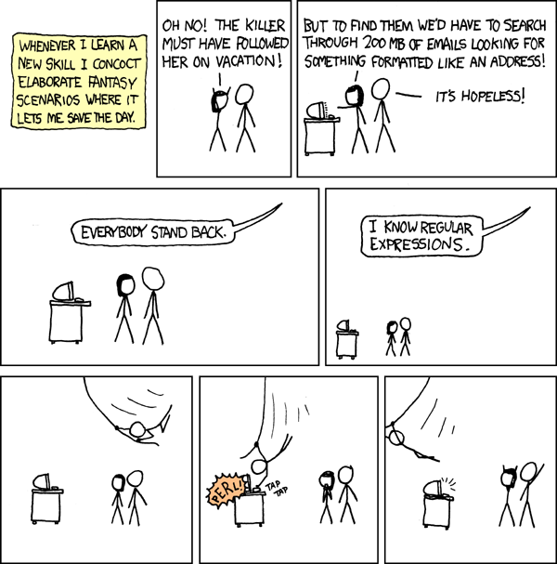
There is an XKCD for Everything
http://xkcd.com/208/

Slide 63
Regular Expression Quick Guide
^ Matches the beginning of a line
$ Matches the end of the line
. Matches any character
* Repeats a character zero or more times
*? Repeats a character zero or more times (non-greedy)
+ Repeats a character one or more times
+? Repeats a character one or more times (non-greedy)
[aeiou] Matches a single character in the listed set
[^XYZ] Matches a single character not in the listed set
[a-z0-9] The set of characters can include a range
( Indicates where string extraction is to start
) Indicates where string extraction is to end
https://www.pg4e.com/lectures/04-Text-Regex-Handout.txt

Slide 64
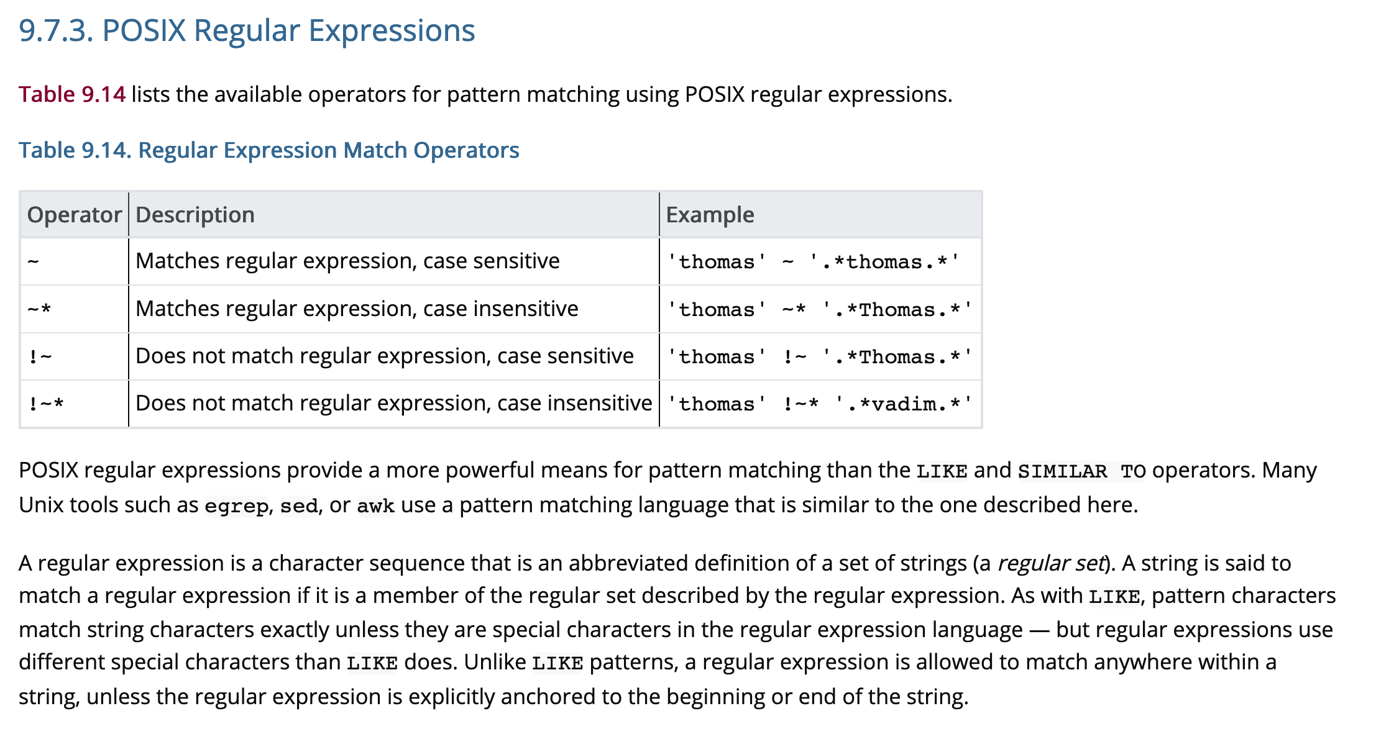
PostgreSQL documentation is good. Lots of online examples.
https://www.postgresql.org/docs/11/functions-matching.html#FUNCTIONS-POSIX-REGEXP

Slide 65
Where Clause Operators
~ Matches
~* Matches case insensitive
!~ Does not match
!~* Does not match case insensitive
Different than LIKE – Match anywhere
tweet ~ 'UMSI'
tweet LIKE '%UMSI%'
https://www.postgresql.org/docs/11/functions-matching.html#FUNCTIONS-POSIX-REGEXP

Slide 66
The simplest regex is like LIKE
CREATE TABLE em (id serial, primary key(id), email text);
INSERT INTO em (email) VALUES ('csev@umich.edu');
INSERT INTO em (email) VALUES ('coleen@umich.edu');
INSERT INTO em (email) VALUES ('sally@uiuc.edu');
INSERT INTO em (email) VALUES ('ted79@umuc.edu');
INSERT INTO em (email) VALUES ('glenn1@apple.com');
INSERT INTO em (email) VALUES ('nbody@apple.com');
discuss=> SELECT email FROM em WHERE email ~ 'umich';
email
------------------
csev@umich.edu
coleen@umich.edu

Slide 67
discuss=> SELECT email from em;
email
------------------
csev@umich.edu
coleen@umich.edu
sally@uiuc.edu
ted79@umuc.edu
glenn1@apple.com
nbody@apple.com
discuss=> SELECT email FROM em WHERE email ~ 'umich';
email
------------------
csev@umich.edu
coleen@umich.edu
discuss=> SELECT email FROM em WHERE email ~ '^c';
email
------------------
csev@umich.edu
coleen@umich.edu

Slide 68
discuss=> SELECT email from em;
email
------------------
csev@umich.edu
coleen@umich.edu
sally@uiuc.edu
ted79@umuc.edu
glenn1@apple.com
nbody@apple.com
discuss=> SELECT email FROM em WHERE email ~ 'edu$';
email
------------------
csev@umich.edu
coleen@umich.edu
sally@uiuc.edu
ted79@umuc.edu
discuss=> SELECT email FROM em WHERE email ~ '^[gnt]';
email
-----------------
ted79@umuc.edu
glenn@apple.com
nbody@apple.com

Slide 69
discuss=> SELECT email from em;
email
------------------
csev@umich.edu
coleen@umich.edu
sally@uiuc.edu
ted79@umuc.edu
glenn1@apple.com
nbody@apple.com
discuss=> SELECT email FROM em WHERE email ~ '[0-9]';
email
------------------
ted79@umuc.edu
glenn1@apple.com
(2 rows)
discuss=> SELECT email FROM em
discuss-> WHERE email ~ '[0-9][0-9]';
email
----------------
ted79@umuc.edu

Slide 70
discuss=> SELECT substring(email FROM '[0-9]+')
discuss-> FROM em WHERE email ~ '[0-9]';
substring
-----------
79
1
discuss=> SELECT substring(email FROM '.+@(.*)$') FROM em;
substring
-----------
umich.edu
umich.edu
uiuc.edu
umuc.edu
apple.com
apple.com

Slide 71
discuss=> SELECT DISTINCT substring(email FROM '.+@(.*)$') FROM em;
substring
-----------
apple.com
uiuc.edu
umuc.edu
umich.edu
discuss=> SELECT substring(email FROM '.+@(.*)$'),
discuss-> count(substring(email FROM '.+@(.*)$'))
discuss-> FROM em GROUP BY substring(email FROM '.+@(.*)$');
substring | count
-----------+-------
apple.com | 2
uiuc.edu | 1
umuc.edu | 1
umich.edu | 2

Slide 72
Multiple Matches
The substring() gets the first match in a text column
We can get an array of matches using regexp_matches()
CREATE TABLE tw (id serial, primary key(id), tweet text);
INSERT INTO tw (tweet) VALUES ('This is #SQL and #FUN stuff');
INSERT INTO tw (tweet) VALUES ('More people should learn #SQL from #UMSI');
INSERT INTO tw (tweet) VALUES ('#UMSI also teaches #PYTHON');

Slide 73
discuss=> SELECT tweet FROM tw;
tweet
------------------------------------------
This is #SQL and #FUN stuff
More people should learn #SQL from #UMSI
#UMSI also teaches #PYTHON
discuss=> SELECT id, tweet FROM tw WHERE tweet ~ '#SQL';
id | tweet
----+------------------------------------------
1 | This is #SQL and #FUN stuff
2 | More people should learn #SQL from #UMSI

Slide 74
discuss=> SELECT regexp_matches(tweet,'#([A-Za-z0-9_]+)', 'g') FROM tw;
regexp_matches
----------------
{SQL}
{FUN}
{SQL}
{UMSI}
{UMSI}
{PYTHON}
discuss=> SELECT DISTINCT regexp_matches(tweet,'#([A-Za-z0-9_]+)', 'g')
discuss-> FROM tw;
regexp_matches
----------------
{FUN}
{UMSI}
{SQL}
{PYTHON}

Slide 75
discuss=> SELECT tweet FROM tw;
tweet
------------------------------------------
This is #SQL and #FUN stuff
More people should learn #SQL from #UMSI
#UMSI also teaches #PYTHON
(3 rows)
discuss=> SELECT id, regexp_matches(tweet,'#([A-Za-z0-9_]+)', 'g')
discuss-> FROM tw;
id | regexp_matches
----+----------------
1 | {SQL}
1 | {FUN}
2 | {SQL}
2 | {UMSI}
3 | {UMSI}
3 | {PYTHON}

Slide 76
DEMO Reading Email

Slide 77
-- https://www.pg4e.com/lectures/mbox-short.txt
CREATE TABLE mbox (line TEXT);
\copy mbox FROM 'mbox-short.txt' with delimiter E'\007';
SELECT line FROM mbox WHERE line ~ '^From ';
SELECT substring(line, ' (.+@[^ ]+) ') FROM mbox WHERE line ~ '^From ';
SELECT substring(line, ' (.+@[^ ]+) '), count(substring(line, ' (.+@[^ ]+) '))
FROM mbox WHERE line ~ '^From '
GROUP BY substring(line, ' (.+@[^ ]+) ')
ORDER BY count(substring(line, ' (.+@[^ ]+) ')) DESC;
SELECT email, count(email) FROM
( SELECT substring(line, ' (.+@[^ ]+) ') AS email
FROM mbox WHERE line ~ '^From '
) AS badsub
GROUP BY email ORDER BY count(email) DESC;

Slide 78
Summary

Slide 79
Acknowledgements / Contributions
These slides are Copyright 2019- Charles R. Severance (www.dr-chuck.com) as part of www.pg4e.com and made available under a Creative Commons Attribution 4.0 License. Please maintain this last slide in all copies of the document to comply with the attribution requirements of the license. If you make a change, feel free to add your name and organization to the list of contributors on this page as you republish the materials.
Initial Development: Charles Severance, University of Michigan School of Information
Insert new Contributors and Translators here including names and dates
Continue new Contributors and Translators here

